Slide 1
Quantitative Peak Fitting GIWAXS Analysis Aiding AI decision-making
Presenter: Carly Zincone
Course: CME 502
Date: May 6th 2025

Slide 2
RESEARCH BACKGROUND

Slide 3
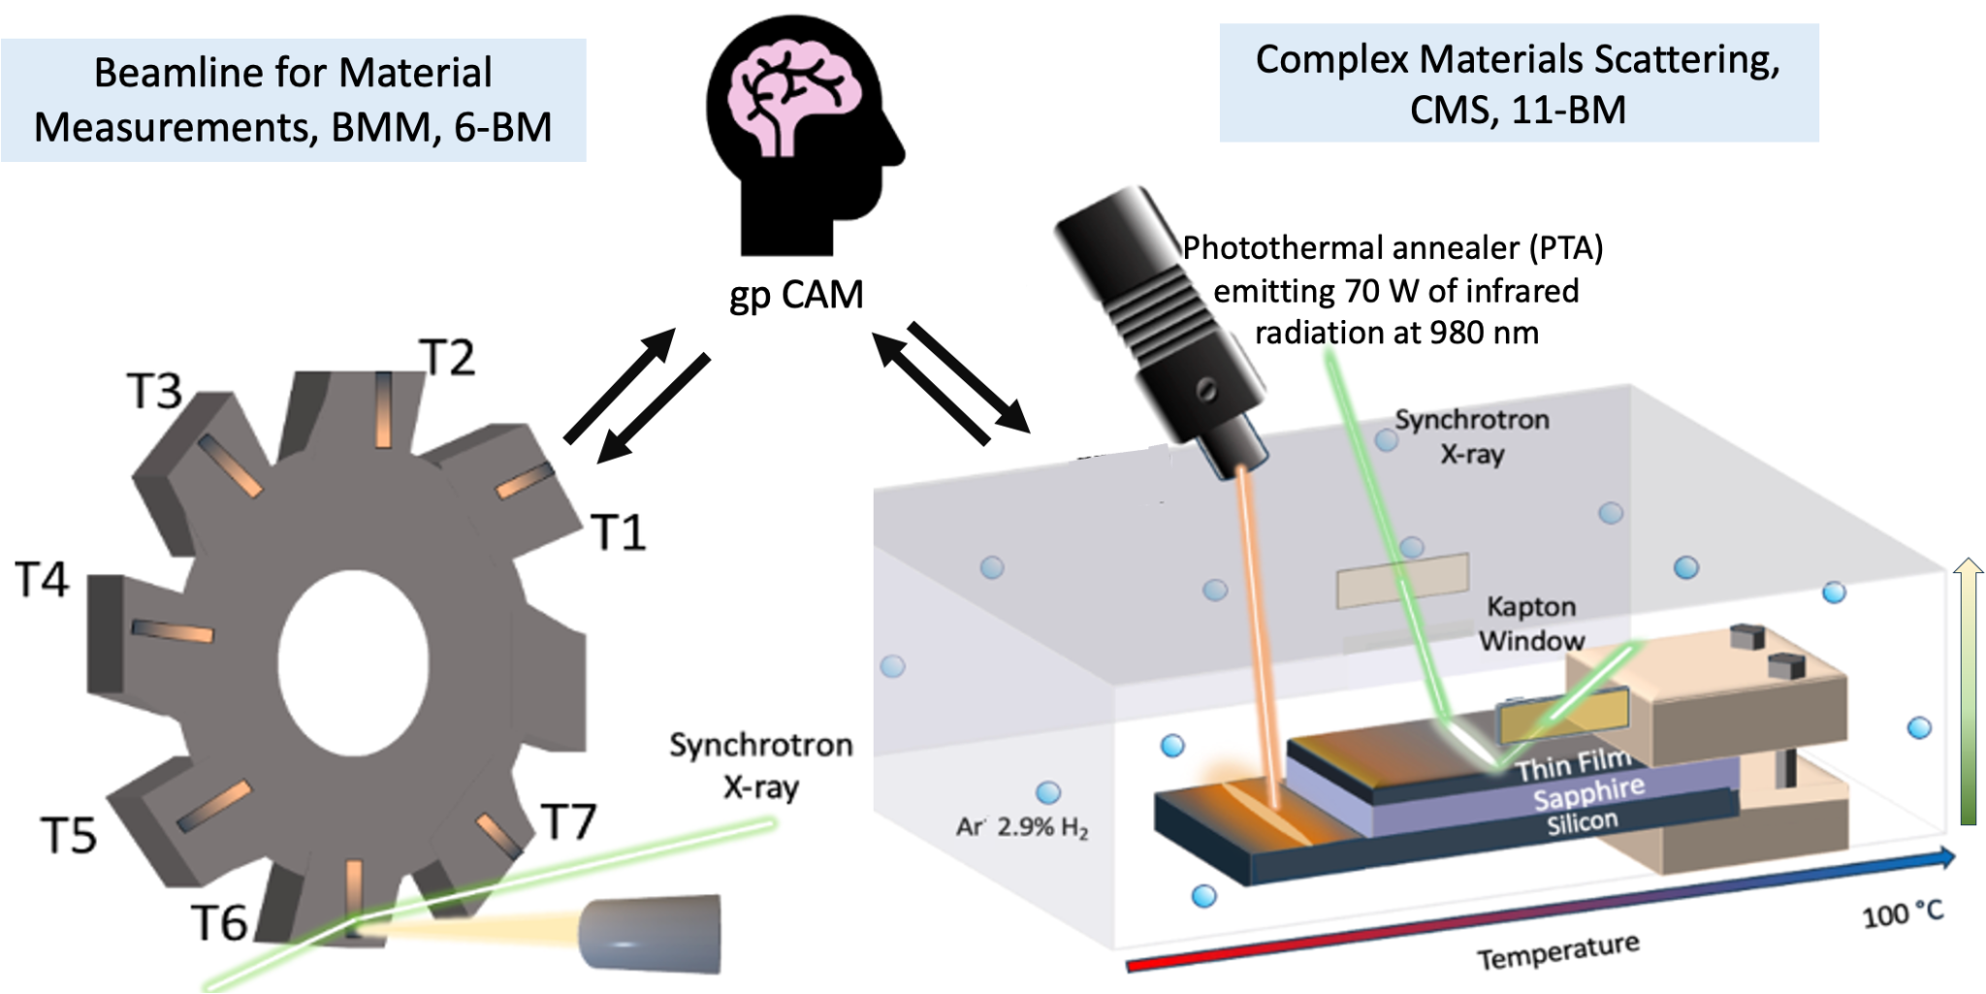
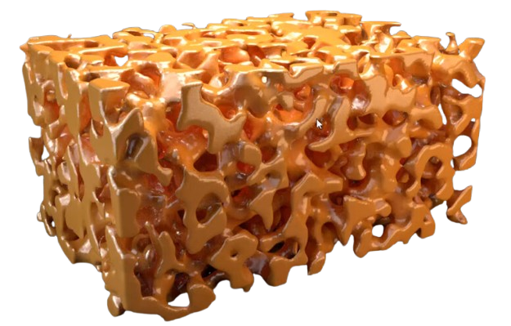
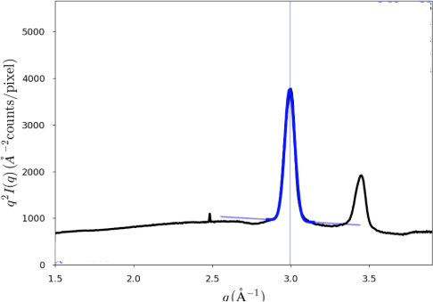
Dealloying in
Thin Films Using Multimodal Characterization
B
1D intensity profile from 2D GIWAXS image by averaging all angles
Ideal for randomly oriented nanostructures
Can help in detecting phase transformations within our sample along the temperature gradient
A
C
Bicontinuous Nanoporous Structure
Immiscible
Miscible

Slide 4
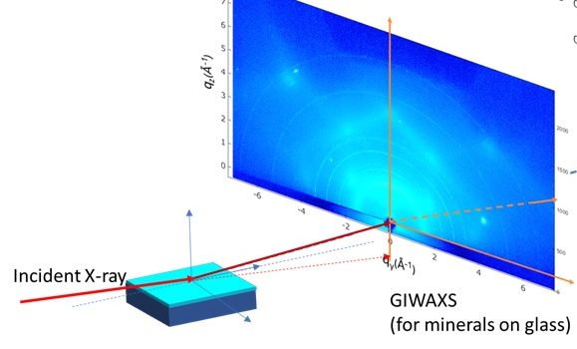
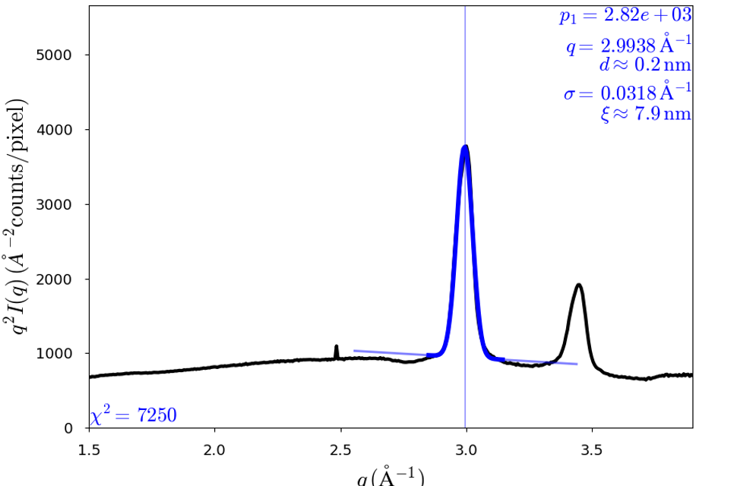
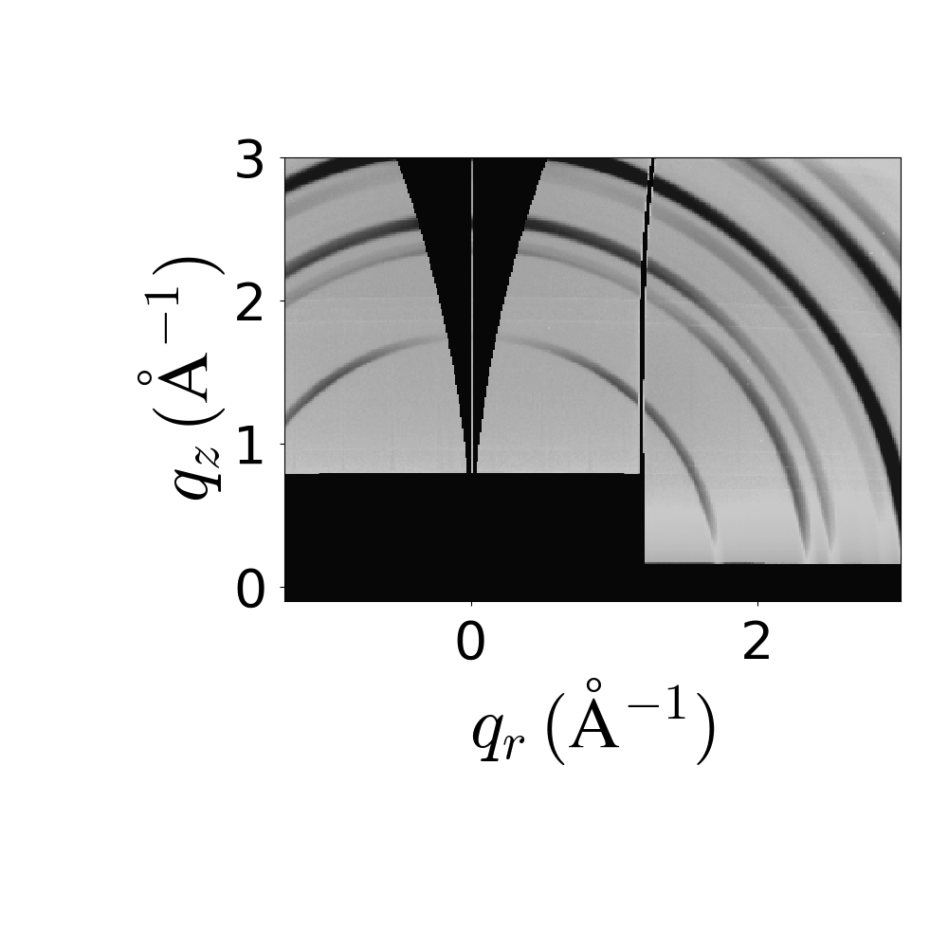

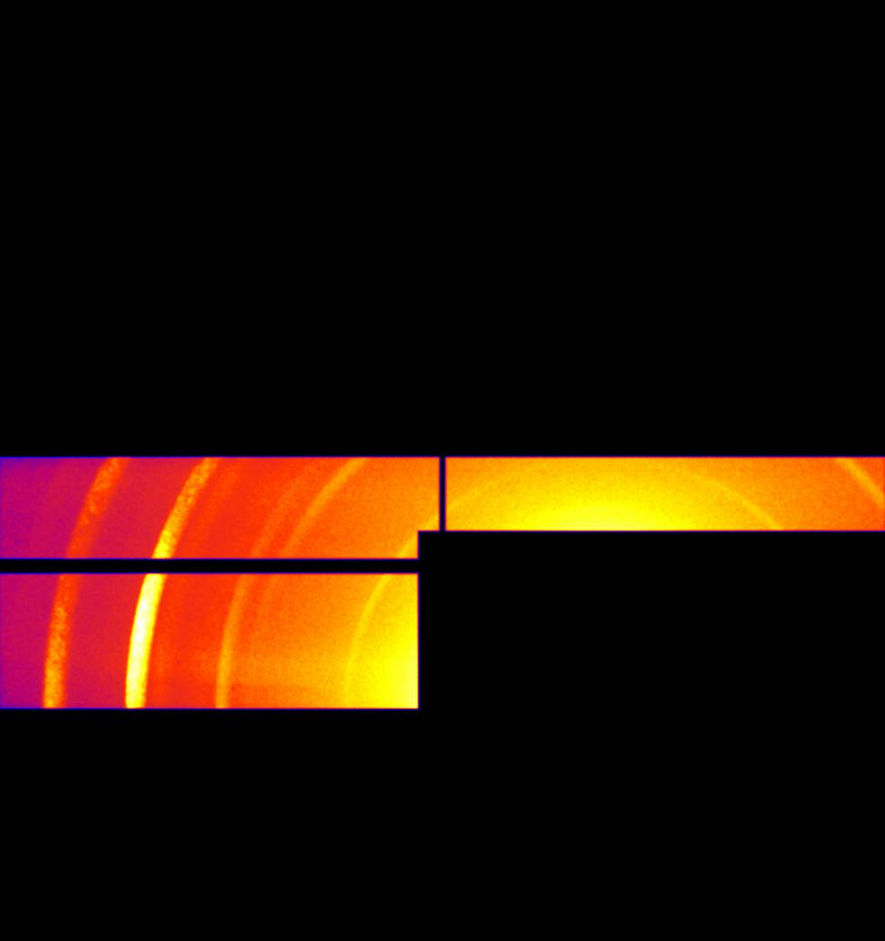
What is GIWAXS?
Grazing Incidence Wide Angle X-ray Scattering
An advanced X-ray scattering method that analyzes the in-plane structure and orientation of thin films and nanoparticles, including their crystal structure, domain dimensions, and orientation.
Helps identify phase transformations
1D intensity profile from 2D GIWAXS image by averaging all angles
Ideal for randomly oriented nanostructures
Can help in detecting phase transformations within our sample along the temperature gradient
MASK

Slide 5
Why Peak Quality Matters?
Broadened peaks = possible species transformation (ie. oxidation).
Autonomous systems like gpCAM must distinguish valid data from noise.

Slide 6
AUTONOMY DILEMMA

Slide 7

What is the problem?
So what is the goal?
gpCAM searches between both samples at their respective beamlines. When collecting GIWAXS data, sometimes it fails to fit a peak of interest (in this case, Cu) during experimentation.
Automate validation of a specific Cu diffraction peak (q ≈ 3.0 Å⁻¹).
Assign 0 to invalid fits (wrong center, too broad, low R²).
Guide gpCAM to focus only on meaningful, sharp-peak regions.

Slide 8
NUMERICAL METHODS

Slide 9
Numerical Methods & Python Libraries
from pathlib import path
from scipy.optimize import curve_fit
from scipy.signal import find_peaks, savgol filter
from sklearn.metrics import r2_score
import numpy as np
import pandas as pd
import matplotlib.pyplot as plt
cleaner way to create pathways to access folders
non-linear least squares fitting
for adaptive peak detection & background subtraction
to quantify fit quality
numerical operations
data manipulation and analysis (dataframes & CSV )
creating visualizations of plots and charts

Slide 10
How the Code Flows?
Raw Data
Baseline Subtraction
Peak Fitting
Validation Logic Separates Good vs Bad
gpCAM ONLY Consumes Validated Data

Slide 11
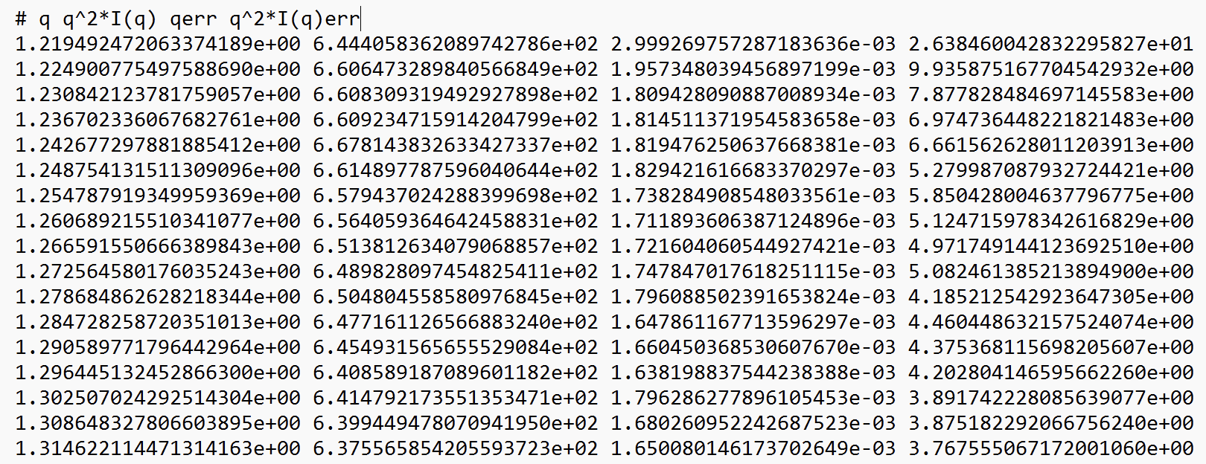
Raw Data / Masking
def process_file(file: Path):
print(f"Processing: {file.name}")
df = pd.read_csv(file, sep=r"\s+", comment="#",
names=["q", "q2Iq", "qerr", "q2Iq_err"], engine="python")
q, I = df["q"].to_numpy(), df["q2Iq"].to_numpy()
mask = (q >= 2.7) & (q <= 3.3)
Raw data
WHY DOES THIS MATTER?
When fitting a Gaussian peak, it requires a minimum number of data points to be meaningful!
Fewer than 10 points, the fit will be mathematically useless.
If a fit is bad, the code will return a dictionary of zeros and empty strings to tell gpCAM not to use, yet providing a placeholder to keep the data pipeline intact
Defines process_file function
Uses pandas to load in raw q vs I data
Skips comment likes & accounts for the spacing to represent column breaks & assigns column names
Extracts columns of interest and converts them to NumPy arrays for numerical processing
Using a boolean mask, allows to select data within a specific q-range
if np.sum(mask) < 10:
return {"filename": file.name, **{k: 0 for k in ['valid', 'amplitude', 'center', 'fwhm', 'r2', 'chi_squared', 'match_score', 'reference_shift']}, 'species': ''}
q_zoom, I_zoom = q[mask], I[mask]
Continuous for about 400 rows
Extracts only the q-range of interest (2.7 - 3.3 Å⁻¹)
q: scattering vector
q2Iq: intensity * q² qerr: error in q
q2Iq_err: error in intensity
Checks how many data points fall within the mask range
The purponp.sum(mask) counts how many “true” values are in the mask

Slide 12
Baseline Subtraction
# ----- Baseline subtraction -----
A = np.vstack([q_zoom, np.ones_like(q_zoom)]).T
coeffs, _, _, _ = np.linalg.lstsq(A, I_zoom, rcond=None)
baseline = A @ coeffs
I_sub = I_zoom - baseline
np.linalg.lstsq() solves a linear system using least square minimization.
Baseline = A @ coeffs → reconstructs the baseline
Goal:
Estimate and subtract a linear background from GIWAXS intensity data to isolate the true diffraction peak.
Method:
Model background: Baseline(q) = m * q + b
Fit a straight line background (baseline) to the intensity data
Subtract that baseline to isolate the true diffraction peak

Slide 13
Gaussian Peak Model + Peak Detection
def gaussian(x, a, x0, sigma, offset):
return a * np.exp(-((x - x0)**2) / (2 * sigma**2)) + offset
noise_floor = np.median(I_sub) + 3 * np.std(I_sub)
peaks, _ = find_peaks(I_sub, height=noise_floor, prominence=0.5 * noise_floor)
if not peaks.size:
raise ValueError("No peaks found.")
peak_idx = peaks[np.argmax(I_sub[peaks])]
Fit peaks using a Gaussian function with an offset to account for baseline noise using amplitude [a], center [x0], width [sigma], background [offset]
Why Gaussian Peak Modeling?
The material used in experimentation is Cu-TiMo-Cu thin film (amorphous)
They work well when the baseline is properly corrected and peaks are isolated.
Calculates threshold based on the background noise in the signal (I_sub)
Set the threshold to 3 standard deviations above the median to help exclude random noise and highlight true peaks
Using find_peaks from scipy.signal searches for a local maximum
A peak is accepted if height is greater than the noise_floor

Slide 14
Peak Fitting
# ----- Peak fitting -----
region = slice(max(0, peak_idx - 25), min(len(q_zoom), peak_idx + 25))
q_fit, I_fit = q_zoom[region], I_sub[region]
offset_guess = np.median(I_fit[:5])
amplitude_guess = I_sub[peak_idx]
init = [amplitude_guess, q_zoom[peak_idx], 0.05, offset_guess]
bounds = ([0, q_fit[0], 0.01, -1e3], [1e6, q_fit[-1], 2.0, 1e3])
popt, _ = curve_fit(gaussian, q_fit, I_fit, p0=init, bounds=bounds)
fit = gaussian(q_fit, *popt)
fit_plot = fit + 700 # For visualization only
Applies nonlinear least squares to fit a Gaussian function around the detected peak.
Importance***
Provides accurate, quantitative values for:
Peak center → relates to lattice spacing
FWHM → indicates crystalline size
Amplitude → relates to phase fraction
Forms the input for autonomous feedback in gpCAM.
We start with an initial guess for amplitude, center, width, and offset based on peak index and local intensity
Iteratively using the curve_fit() method to minimize the squared error between the measured data and the Gaussian model
Apply constraints (bounds) that force the solution stays within physical limits.
Notes:
“This equation is the mathematical goal of our peak fitting process. We’re asking the computer to find the best combination of parameters — the peak height, center, width, and background level — that makes the difference between our experimental data and the Gaussian curve as small as possible.”
“Specifically, it minimizes the sum of the squared errors between what we measured and what the model predicts. This is a classic method in numerical analysis called nonlinear least squares fitting.

Slide 15
Batch Processing Implementation
results = []
for file in folder_path.glob("*.dat"):
result = process_file(file)
if result:
results.append(result)
# Save tabular results
pd.DataFrame(results).to_csv(output_csv, index=False)
print(f"\n Processing complete. Results saved to {output_csv}")
Automates analysis across all .dat files
Ensures consistent peak-fitting criteria for every sample
More efficient than manual processing
Scales easily for high-throughput experiments
Prepares clean input for gpCAM decision-making

Slide 16
Validation Logic Separates Good vs Bad
Invalid Fit:
Broad, off-center, poor Gaussian match
Returned as zeros to gpCAM
broad = fwhm > (REFERENCE_FWHM * MAX_WIDTH_FACTOR)
# checks if the peak is too wide compared to a reference — broader peaks are often less reliable or indicate a different species.
centered = abs(center - 3.0) < 0.15
# confirms the peak is located close to the expected q-value (~ 3.0 Å⁻¹).
is_valid = (r2_fwhm >= 0.5) and not broad and centered
# requires a minimum R² value over the full-width-half-maximum range — ensuring a good fit to the Gaussian model.
Valid Fit:
Centered near q = 3.0 Å⁻¹ → Cu peak
FWHM < threshold → rejects noisey features or if too broad
R² ≥ 0.5 → at least half the data’s variation
FWHM- Full Width @ Half Maximum
Calculated from Gaussian sigma
A narrow FWHM indicates a well-defined, crystalline structure.
A broader FWHM suggests:
Smaller crystallite size
Possible phase transformation

Slide 17
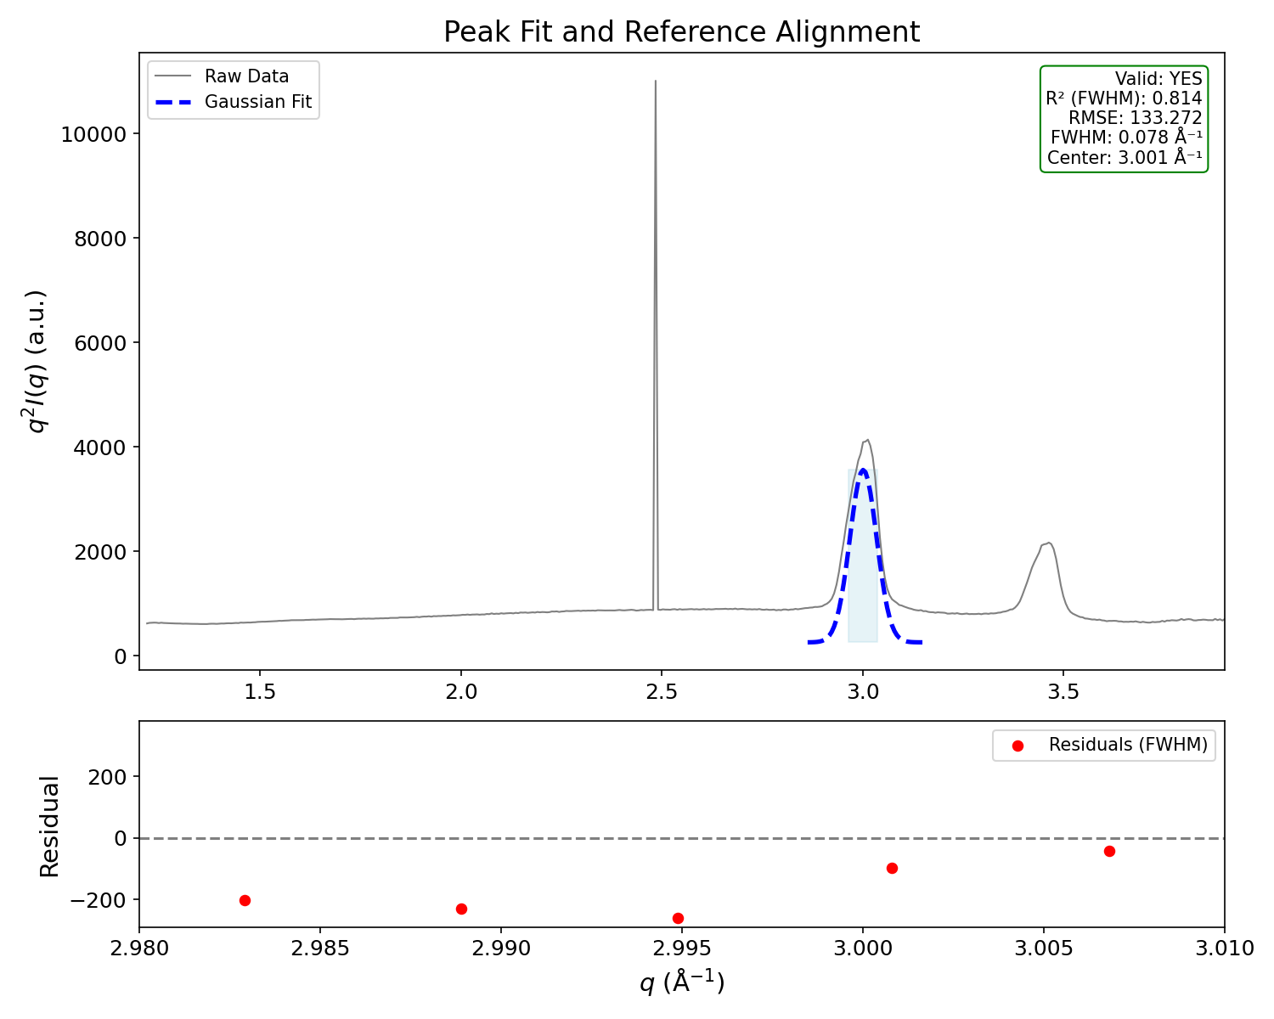
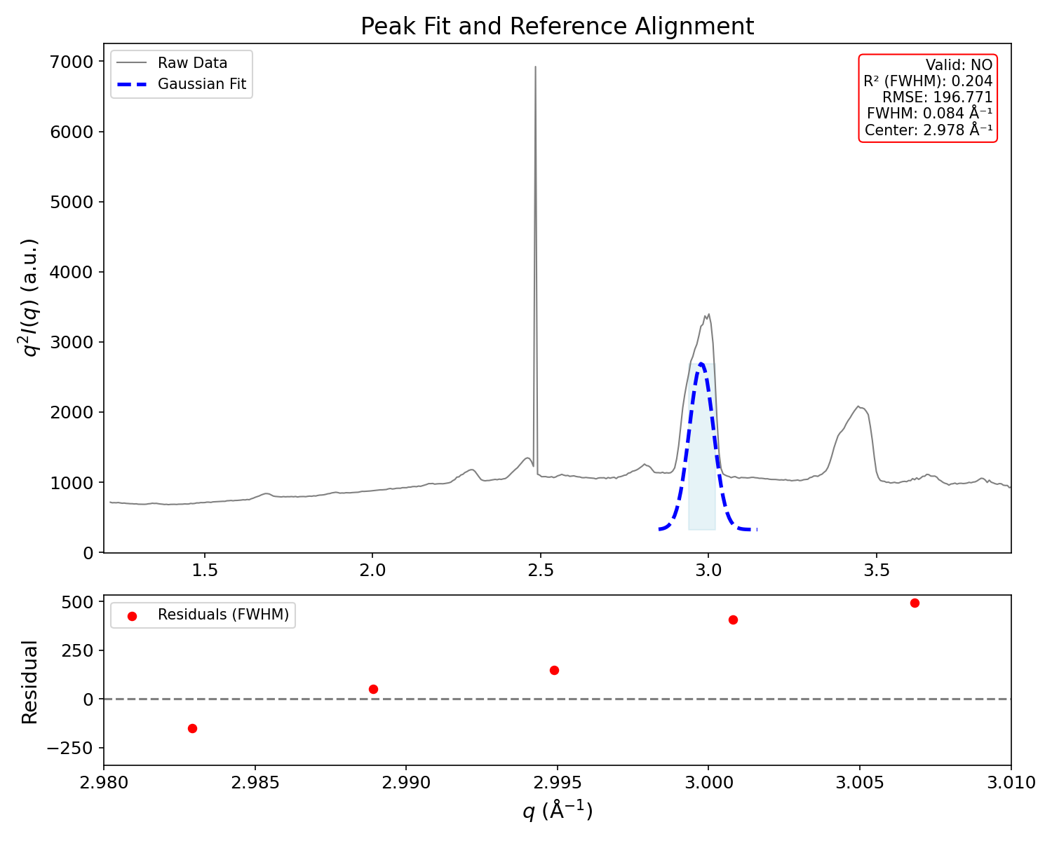
Good Fit VS Bad Fits
Good Fit
Bad Fit
Why is the Gaussian fit not “perfect” ?
Slight asymmetry in the experimental peak shape (real peaks aren’t always symmetric).
Baseline subtraction may have left some curvature or intensity shift.
The baseline I assumed was perfectly linear which could lead to error
Noise in the intensity data can pull the fit slightly off.
R² = 0.814→ 81.4% of the variation in the data within the peak region.
FWHM = 0.078 Å⁻¹ → Narrow and consistent with expected crystallinity.
Center = 3.001 Å⁻¹ → Very close to the target value (~3.0 Å⁻¹).
RMSE = 133.272 → Indicates low average error between model and data.
R² = 0.204 → 20.4% The fit performs worse than a flat line, meaning the Gaussian model poorly describes the peak shape. FWHM = 0.084 Å⁻¹ → Although narrow, it doesn’t compensate for the poor fit shape. Center = 2.978 Å⁻¹ → Shifted peak, although close to the expected location (~3.0 Å⁻¹)
RMSE = 196.77 → High error, indicating large mismatch between data and model.

Slide 18
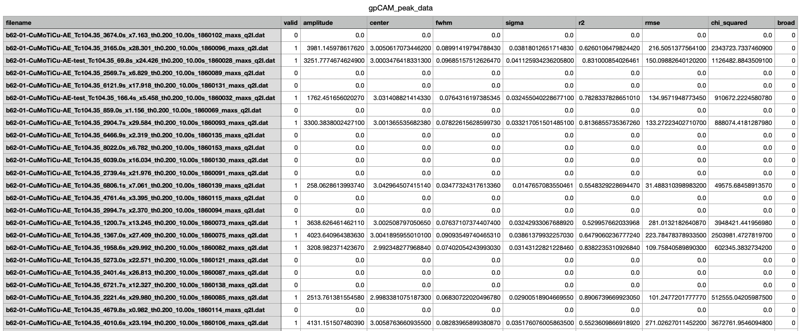
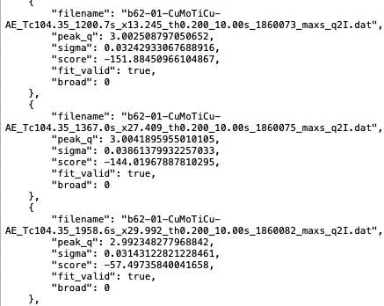
Exporting to CSV & json.
CSV File
Uses pandas to save all numerical results in a table format
Easier to make manual inspection
JSON File
Creates a machine readable format designed for gpCAM
Includes only valid data (preprocessed)
Easily parsed for decision-making/ feedback control

Slide 19
gpCAM ONLY Consumes Validated Data
gpCAM_ready = []
for r in results:
sigma = r.get("sigma", 0)
broad = r.get("broad", 0)
penalty = sigma / REFERENCE_FWHM if sigma else 1
score = -r["rmse"] * penalty if r["valid"] else 0
gpCAM_ready.append({
"filename": r["filename"],
"peak_q": r["center"],
"sigma": sigma,
"score": score,
"fit_valid": bool(r["valid"]),
"broad": broad
})
with open(output_csv.with_suffix(".json"), "w") as f:
json.dump(gpCAM_ready, f, indent=4)
print(f"gpCAM-compatible results saved to {output_csv.with_suffix('.json')}")
If the fit is valid (r["valid"] == 1):
Compute a score based on how well the peak was fit.
Specifically:
score = −(RMSE) × penalty
RMSE is the root-mean-square error from the Gaussian fit
penalty adjusts based on the sigma/FWHM (e.g., broader peaks = higher penalty)
If the fit is invalid, set the score to 0 so that gpCAM can learn to avoid these inputs

Slide 20
Conclusion / Key Findings
Background subtraction could possibly not be linear throwing off the Gaussian fit
Validate results by using numerical thresholds like R², FWHM, and peak position to tell if a fit was good or bad.
Implemented batch processing to improve efficiency and consistency
Only valid fits are saved and scored, so that gpCAM focuses on high-quality data for decision-making.

Slide 21
THANK YOU!

Slide 22
SUGGESTIONS/QUESTIONS

